Slide 1


REAL LIFE LAB GROUP-04 HEALTHCARE

Slide 2
TEAM MEMBERS
NAME | EMPLOYEE ID
Bhoomika R | 2568428
R Nivashini | 2568593
Jinka Prashanthi | 2569270
Rogh Inico Samimuthu | 2568885
Rohith N | 2569336
Shalini P | 2567777
Thammireddy Likhitha | 2567754
Yokesh K | 2569040

Slide 3

CONTENTS
Objectives
Introduction
Technologies Used
Background of Project
Test Scenarios
Feature Files
Screenshot
Outcome
Conclusion

Slide 4
OBJECTIVE
Create a test script to automate the test scenario and generate the reports for Hospital Management website.

Slide 5
INTRODUCTION
Hospital Management Website, a comprehensive solution tailored to enhance the efficiency and effectiveness of hospital operations.
Healthcare is an essential component of our well-being, encompassing a wide range of medical services, treatments, and preventive measures aimed at maintaining and improving our health. It is a dynamic and ever-evolving field that involves healthcare providers.
This user-friendly platform aims to revolutionize healthcare management by providing a range of features and functionalities that streamline patient care, optimize administrative processes, and ensure regulatory compliance.
Benefits of this innovative system, designed to elevate the standards of healthcare services.

Slide 6
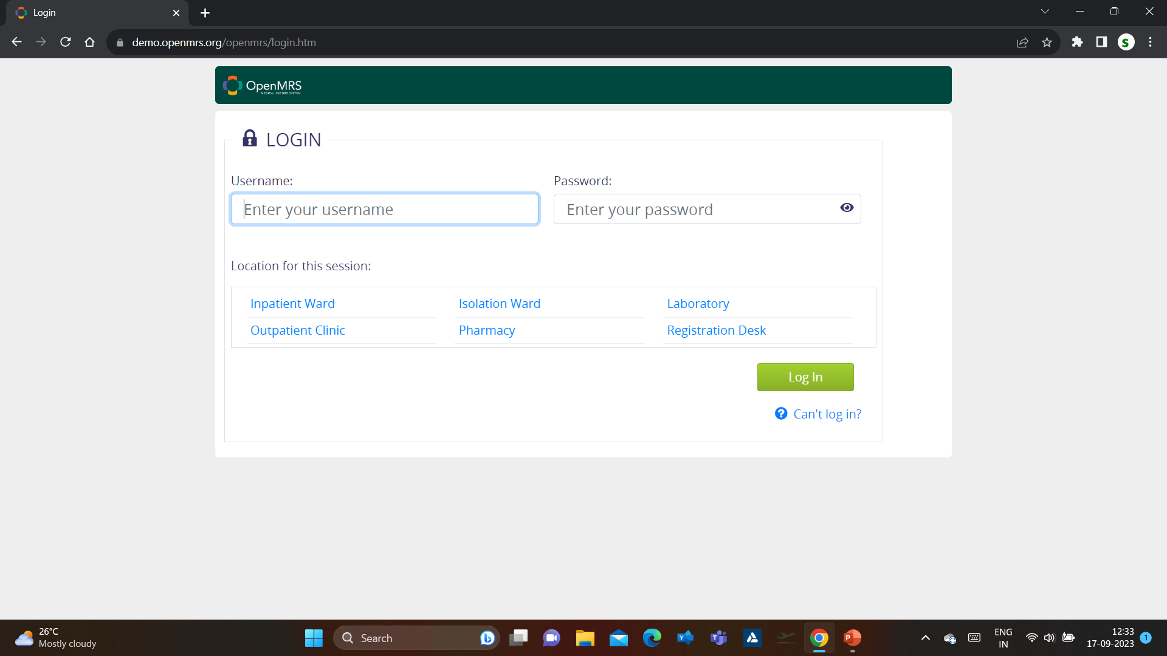
URL for AUT (Application Under Test)
https://demo.openmrs.org/openmrs/login.htm

Slide 7
TECHNOLOGIES USED
Selenium
TestNG (Execution , Listeners)
Cucumber
Listener
Framework

Slide 8

Selenium
Introduction to Selenium
Popular open-source framework primarily used for automating web browsers.
Provides a set of tools and libraries for interacting with web applications through web browsers.
Key Features of Selenium
Selenium's Components
Supported Browsers
Selenium vs. Manual Testing
Use Cases
Challenges and Limitations

Slide 9

TestNG
Introduction to TestNG
TestNG is a powerful testing framework.
An enhanced version of JUnit which was in use for a long time before TestNG came into existence.
Key Features of TestNG
Supports annotations.
Supports testing integrated classes
Flexible plug-in API.
Support for multi threaded testing.

Slide 10

Cucumber
Introduction to Cucumber
Cucumber is a popular open-source tool used in software development and testing. It is primarily used for behavior-driven development (BDD) and acceptance testing.
Features of Cucumber
Human-readable test cases
Support for multiple programming languages
Integration with various testing frameworks
What is BDD?
Gherkin Language
Some Benefits of Gherkin Language – Clarity, Readability, Collaboration and Reusability

Slide 11
Listeners
Introduction to Listeners
Listener Listeners in Selenium are classes that implement specific interfaces in order to track events that occur during the execution of Selenium tests.
Types of Selenium Listeners
WebDriver Listeners the web driver listener interface can implement classes and methods like EventFiringWebDriver and WebDriverEventListener
TestNG Listeners TestNG provides the @Listeners annotation which listens to every event that occurs in a selenium code. Listeners are activated either before the test or after the test case. It is an interface that modifies the TestNG behavior.
Benefits Of Using Listeners
Enhanced Test Reporting
Test Result Analysis
Test Data Manipulation

Slide 12
Framework
Introduction to Selenium Frameworks
Provide a structured approach to designing and managing test scripts
Features of Framework
Data-Driven Framework
Keyword-Driven Framework
Page Object Model (POM)
Behaviour-Driven Development (BDD) with Cucumber
Hybrid Framework

Slide 13


BACKGROUND OF THE PROJECT
Mphasis has developed a new site for hospital management. It provides the user with different options for hospital management.
Login Credentials:
Username: admin
Password: Admin123
Following are functionalities for the site:
Login as inpatient Ward
Register a patient.
Find Patient Record.
Manage Service Types
Manage Appointments
Manage Appointment Blocks
Capture Vitals for Patient
Edit Patient details.

Slide 14
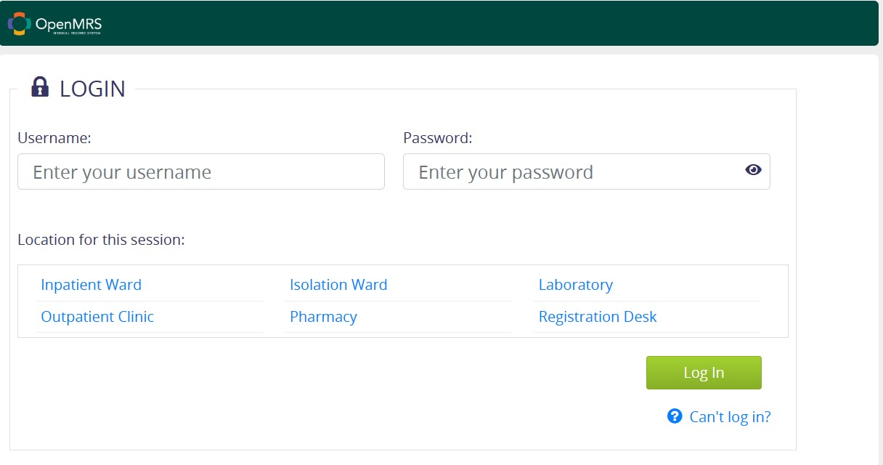
TEST SCENARIO-01
Navigate to the URL,Enter the credentials, and choose the location and click on the login.
Feature: login to openMRS
Background
Given a user is on the login page of openMRS
Scenario:Successful Login
When a user enter the username
When a user enter the password
And he choose the location
And he click on the login button
Then User should be logged in successfully

Slide 15
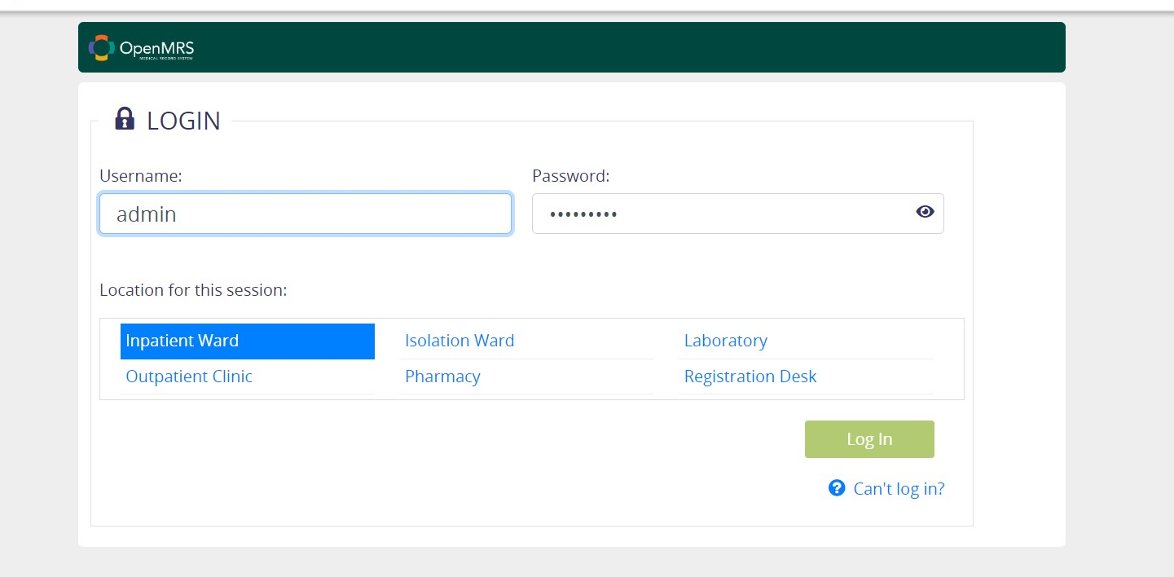
Valid Register a Patient
When a user enters valid username
And valid password
Then select a Location for this session
Then click on the login button
User will be able to login successfully

Slide 16
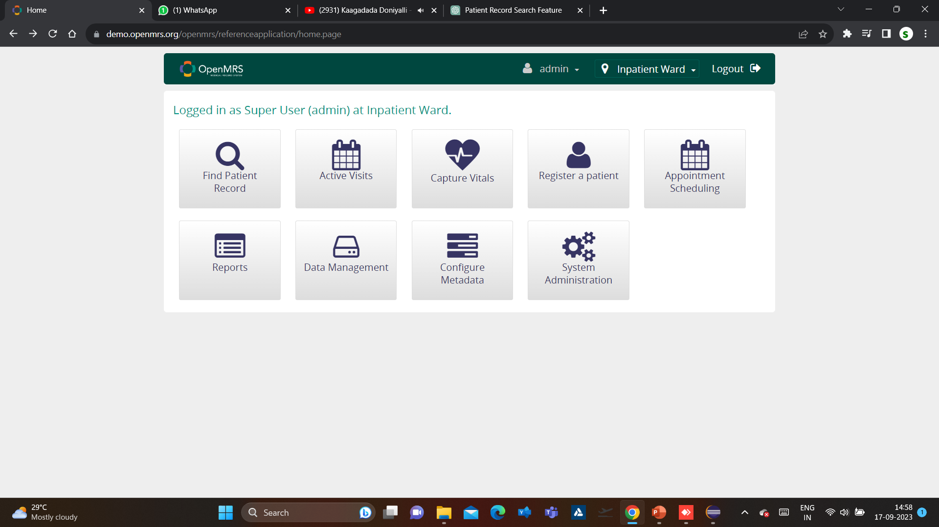
TEST SCENARIO-02
Navigate to the URL, Login into the application. Click on the register a patient. Fill all the details and click Confirm.
Feature File
Feature: Find Patient Record
Background:
Given I am on the application login page
Scenario: Search Patient Record by Name
When I log in with valid credentials
And I click on "Register a Patient"
And I choose to search by Name
And I choose to search by Gender
And I choose to search by Birthdate
And I choose to search by Address
And I choose to search by Phone Number
And I choose to search by Relatives
And I click the "Confirm" button
And I click the "Search" button
Then I should see the Find patient record details

Slide 17
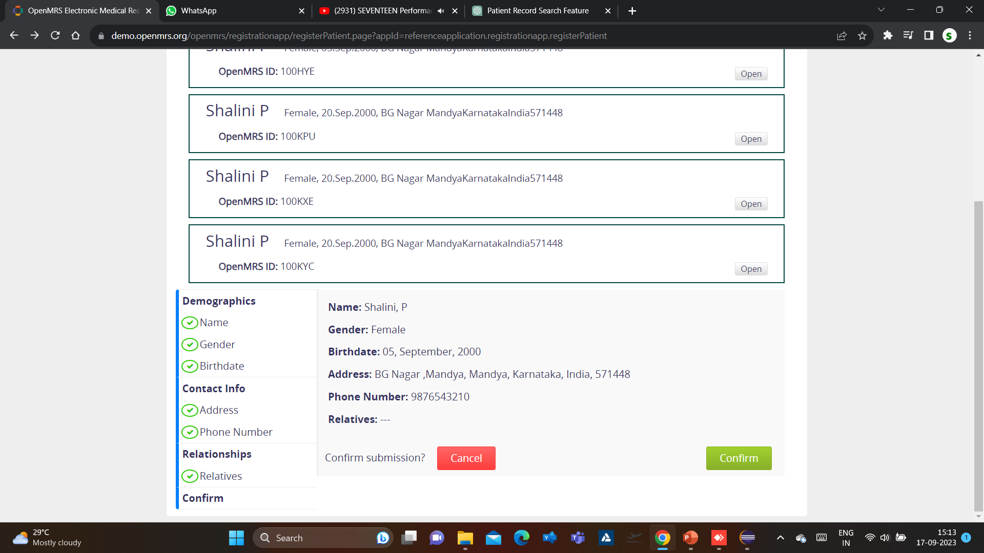
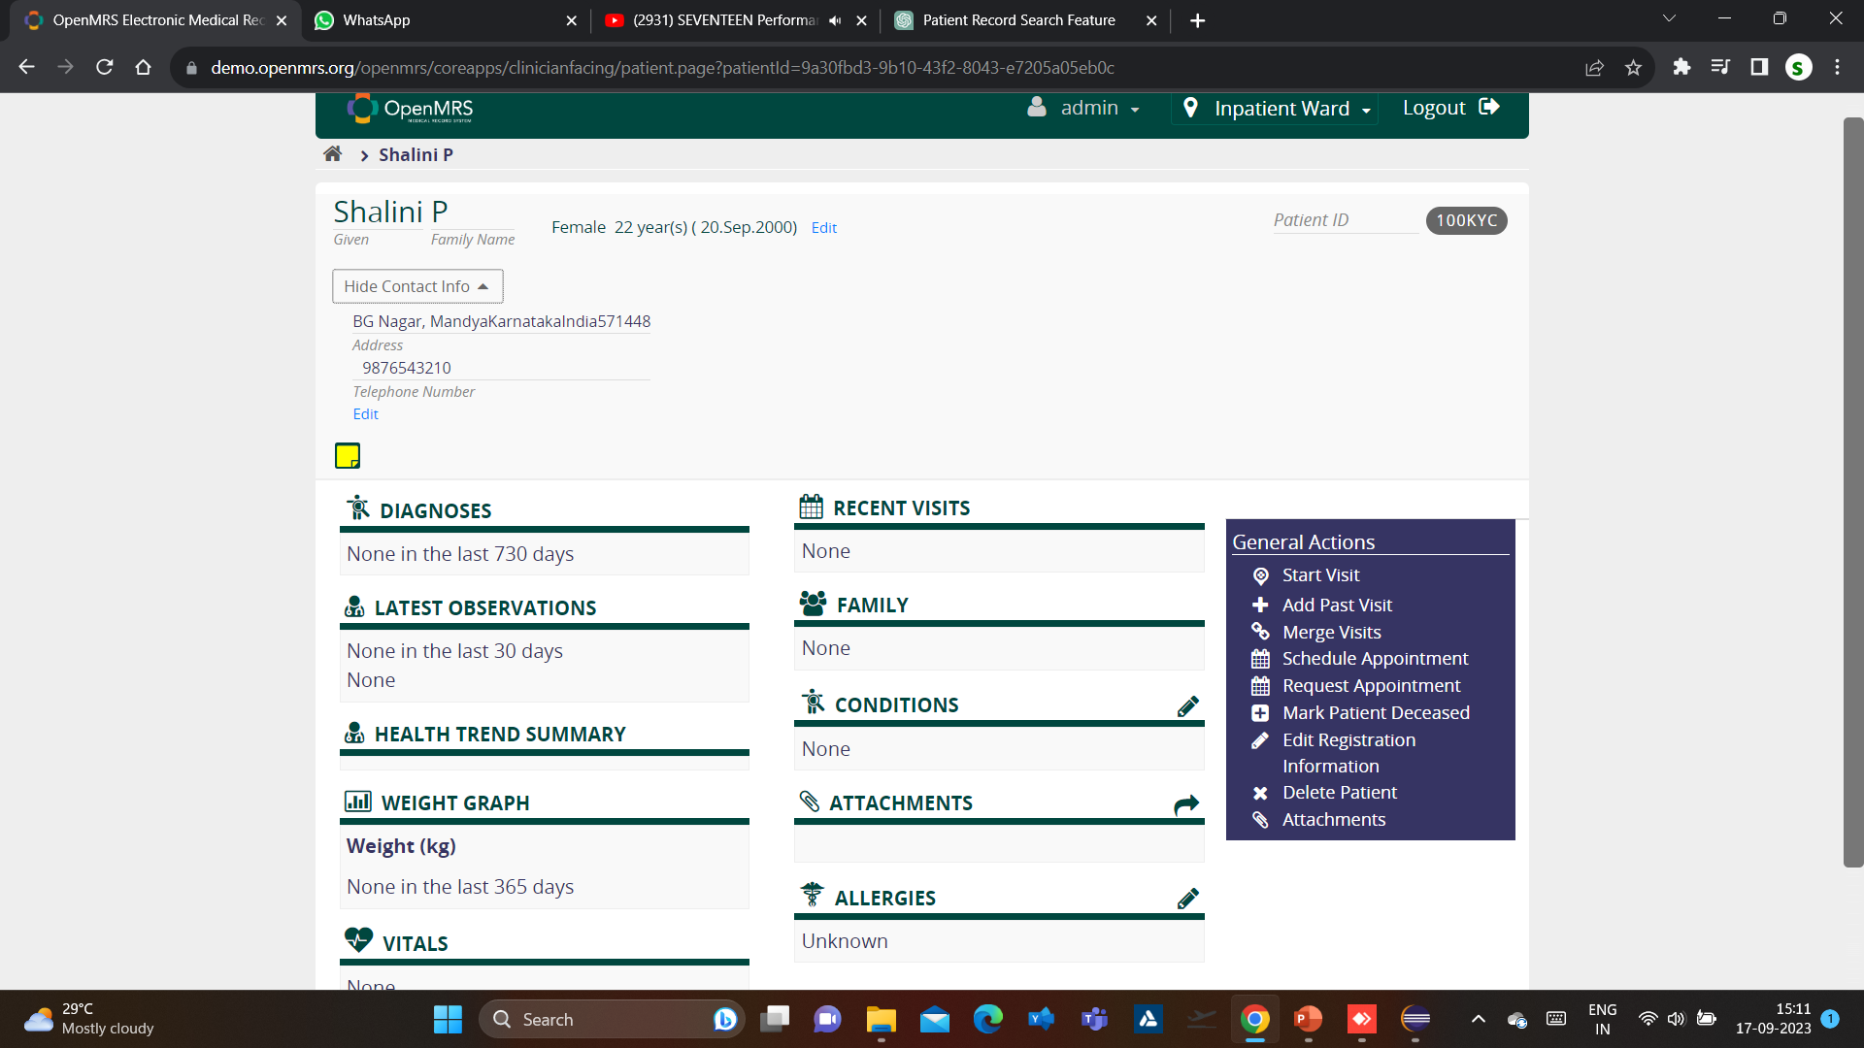
Valid Register a Patient
When I enter an valid Register a patient details
Then I confirm the patient record
Then I search for Find Patient record to verify the patient record are confirmed.

Slide 18
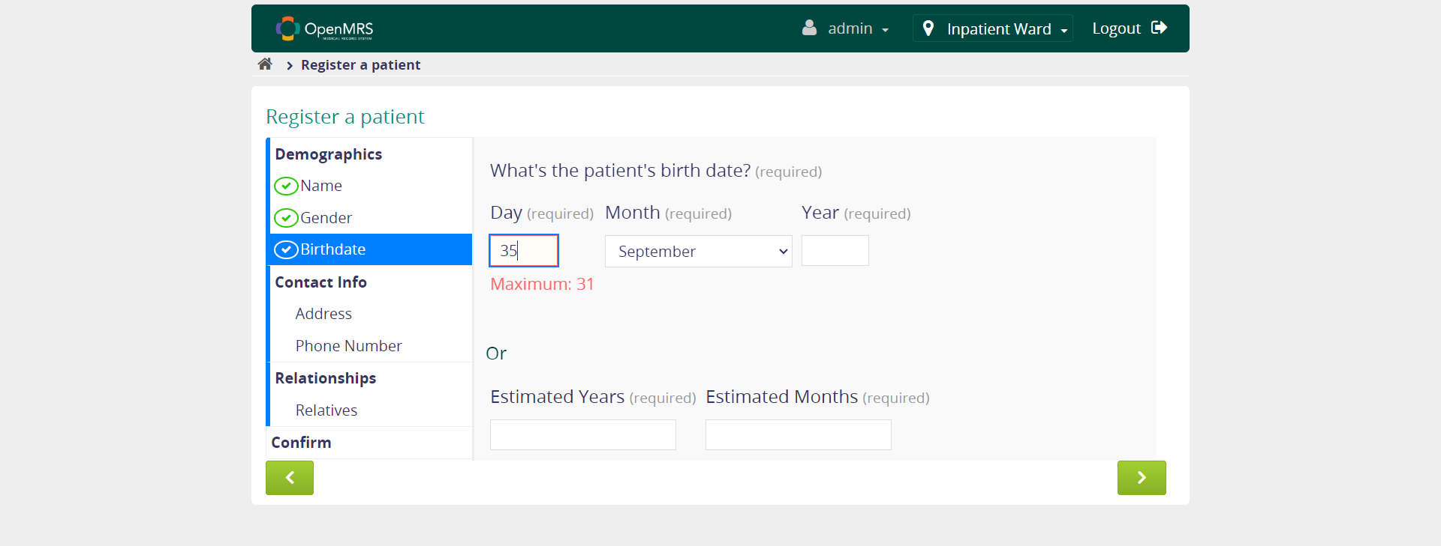
Valid Register a Patient
When I enter an Invalid patient birthdate day in search box
It is checking the invalid maximum value in search box

Slide 19
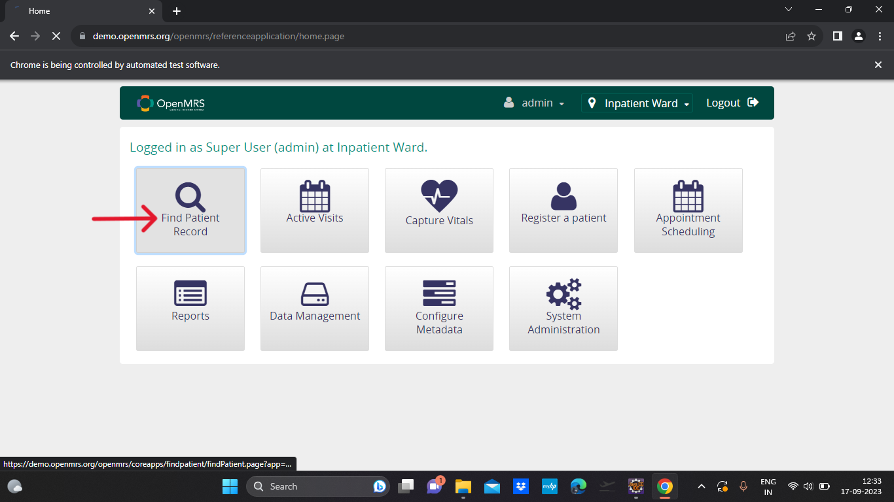
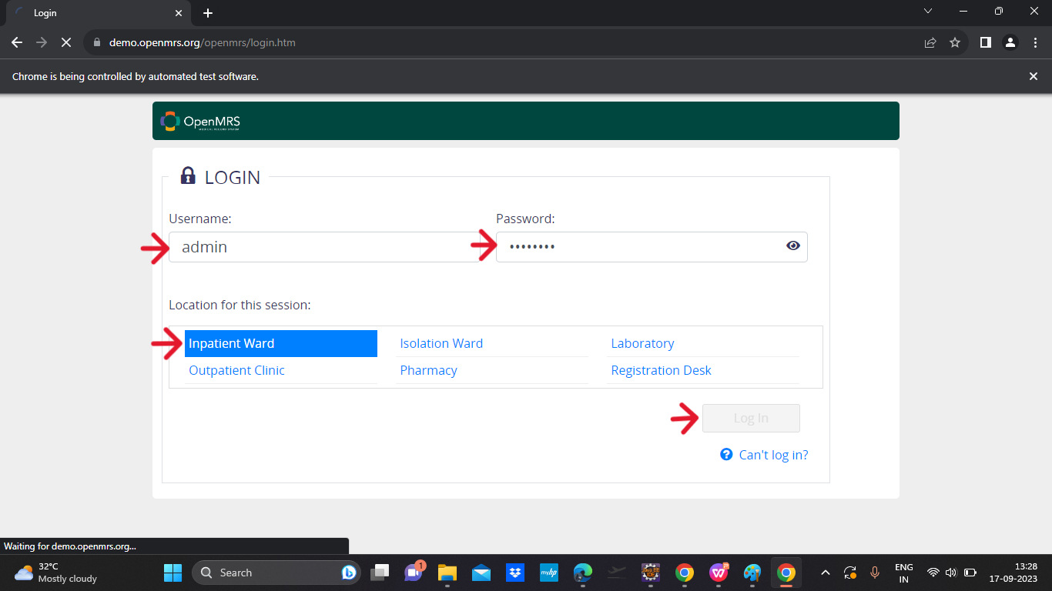
TEST SCENARIO-03
Find Patient Record
Scenario: Navigate to OpenMRS and Perform Patient Record Search
I enter into the OpenMRS login page
I enter my username and password
And I click the Login button
Then I click on the Find Patient Record in Home Page

Slide 20
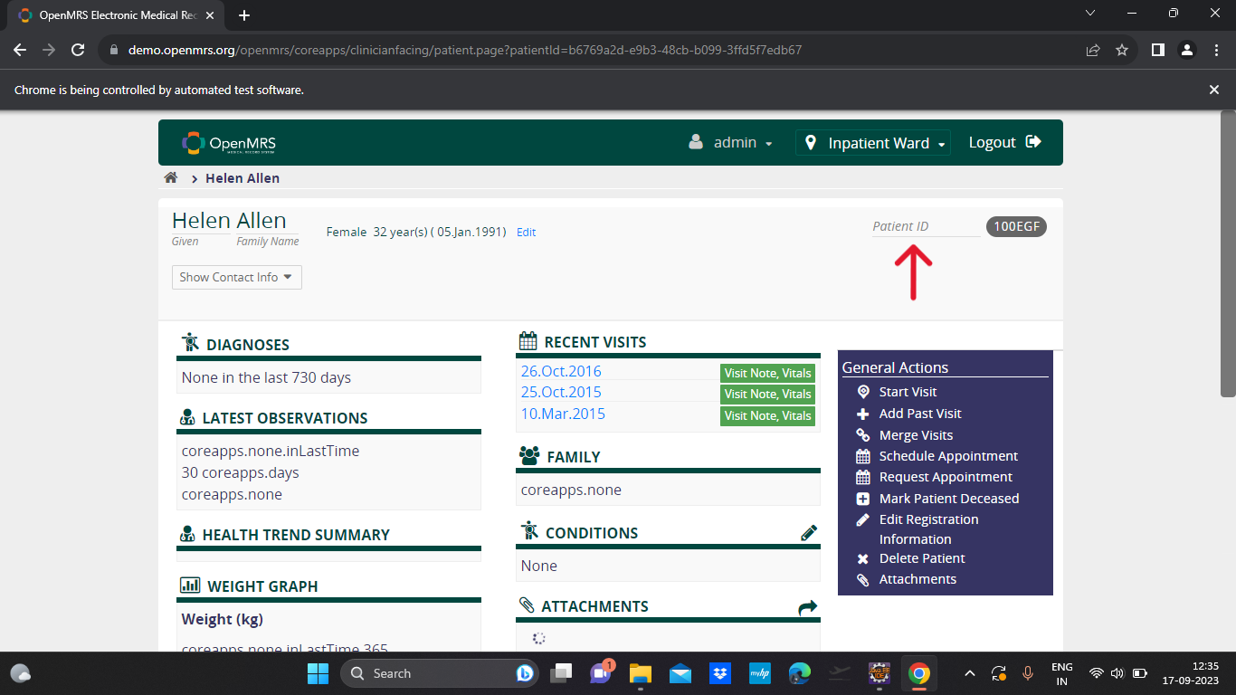
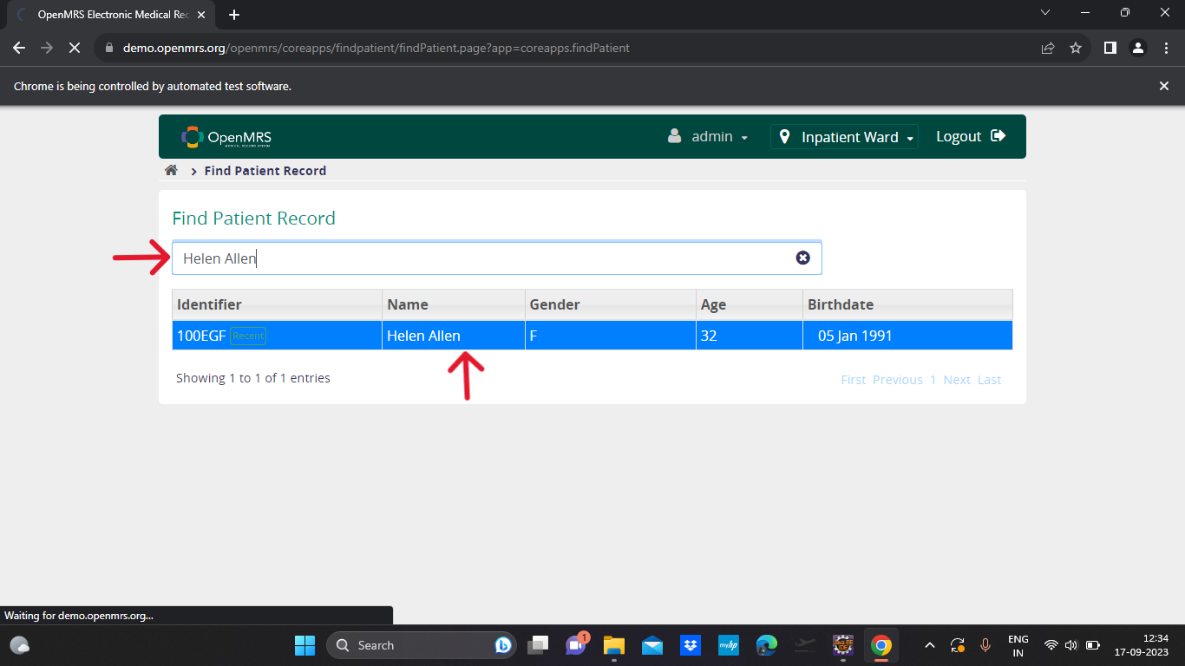
Valid Patient Name or Id
When I enter an valid patient name in search box
And i select the first name and goes to patient details record.
Then I verify the Text
‘Patient Id’.

Slide 21
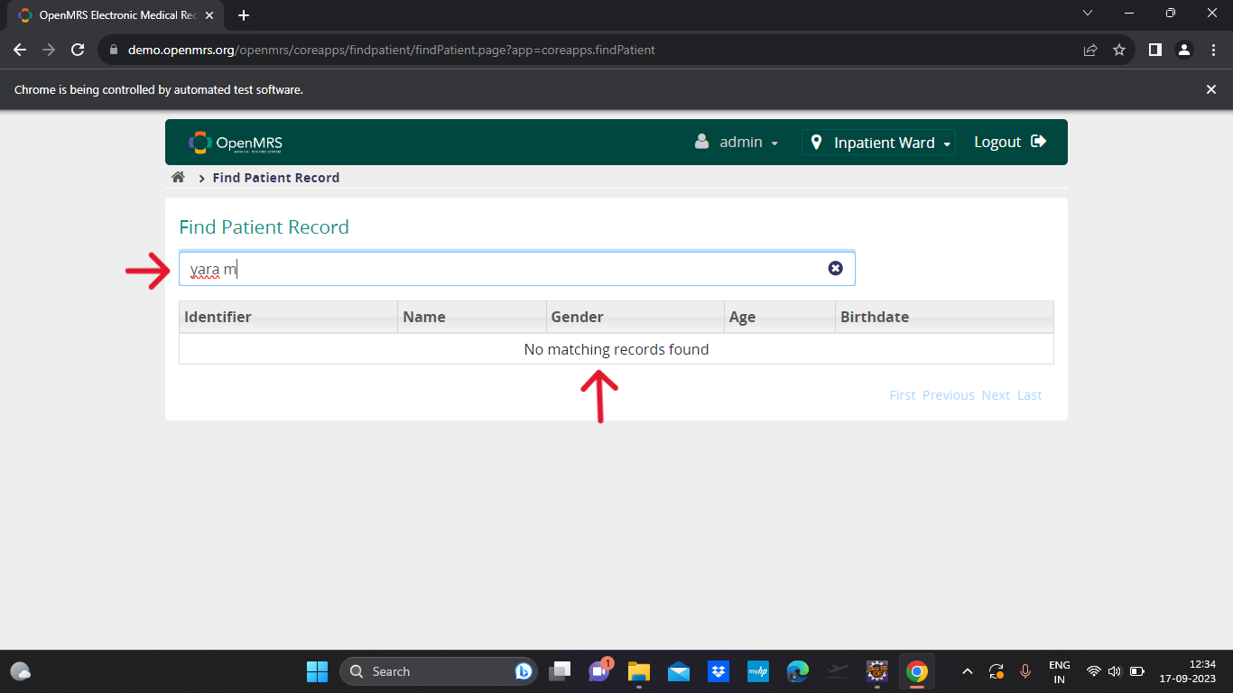
Invalid Patient Name or Id
When I enter an invalid patient name in search box
Verified the error message for invalid search “No matching records found”

Slide 22
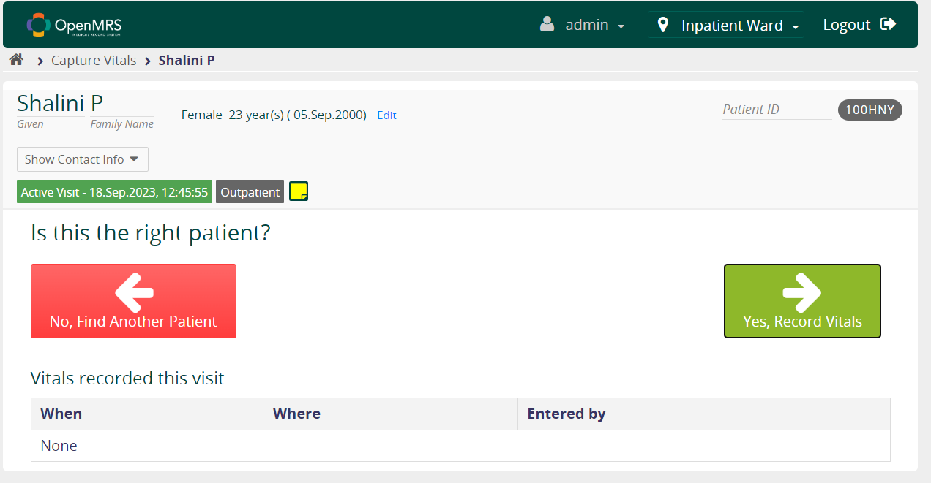
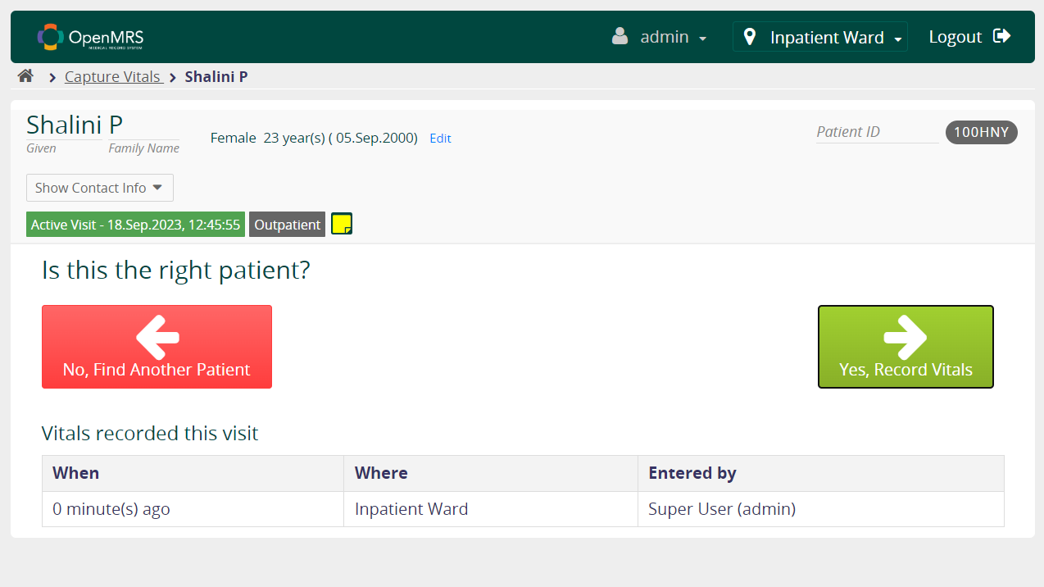
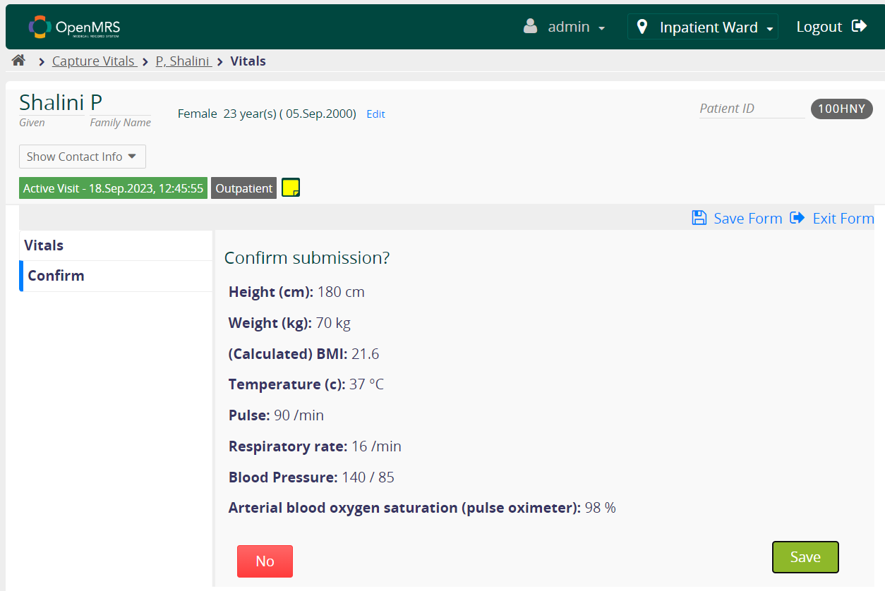
TEST SCENARIO-04
Scenario: Navigate to the URL, login into the application. Click on the Capture Vitals for Patient. Select any patient and Record the Vitals
Capture Vitals with Valid Data
In the capture vitals page select “Yes, Record Vitals”
Enter all the data needed like height, weight, Temperature, etc.
Click save button
We can see the record in the capture vitals page

Slide 23
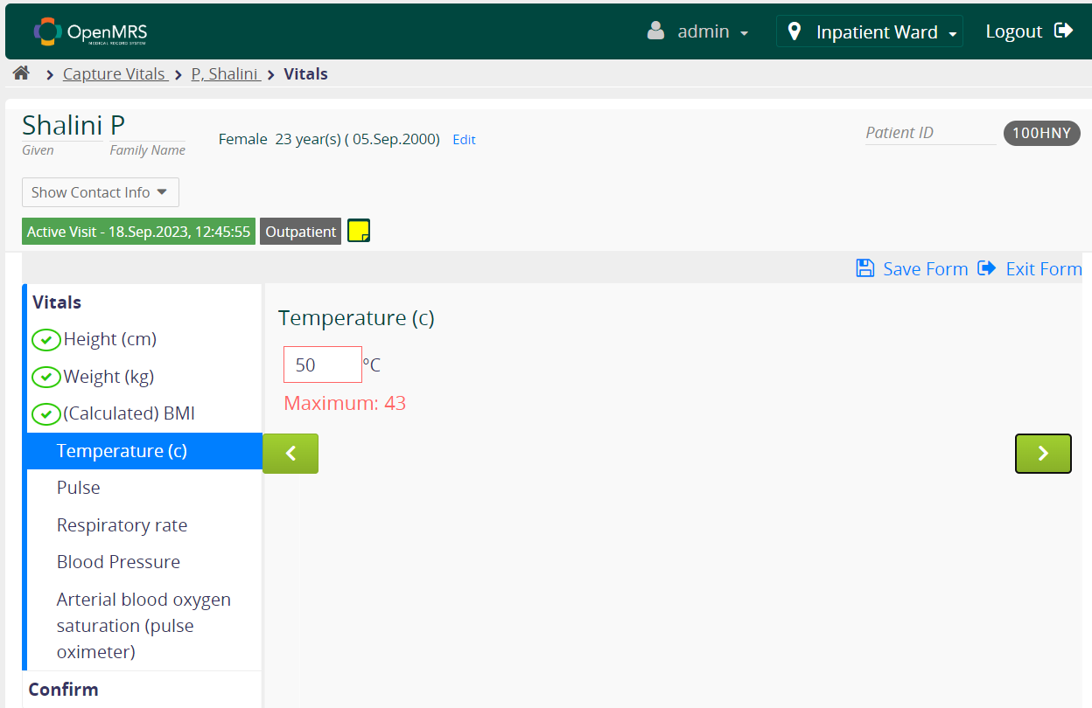
Capture Vitals with Invalid Data
In the capture vitals page select “Yes, Record Vitals”
Enter a invalid data like 50 in Temperature
We get a error message “Maximum: 43”

Slide 24
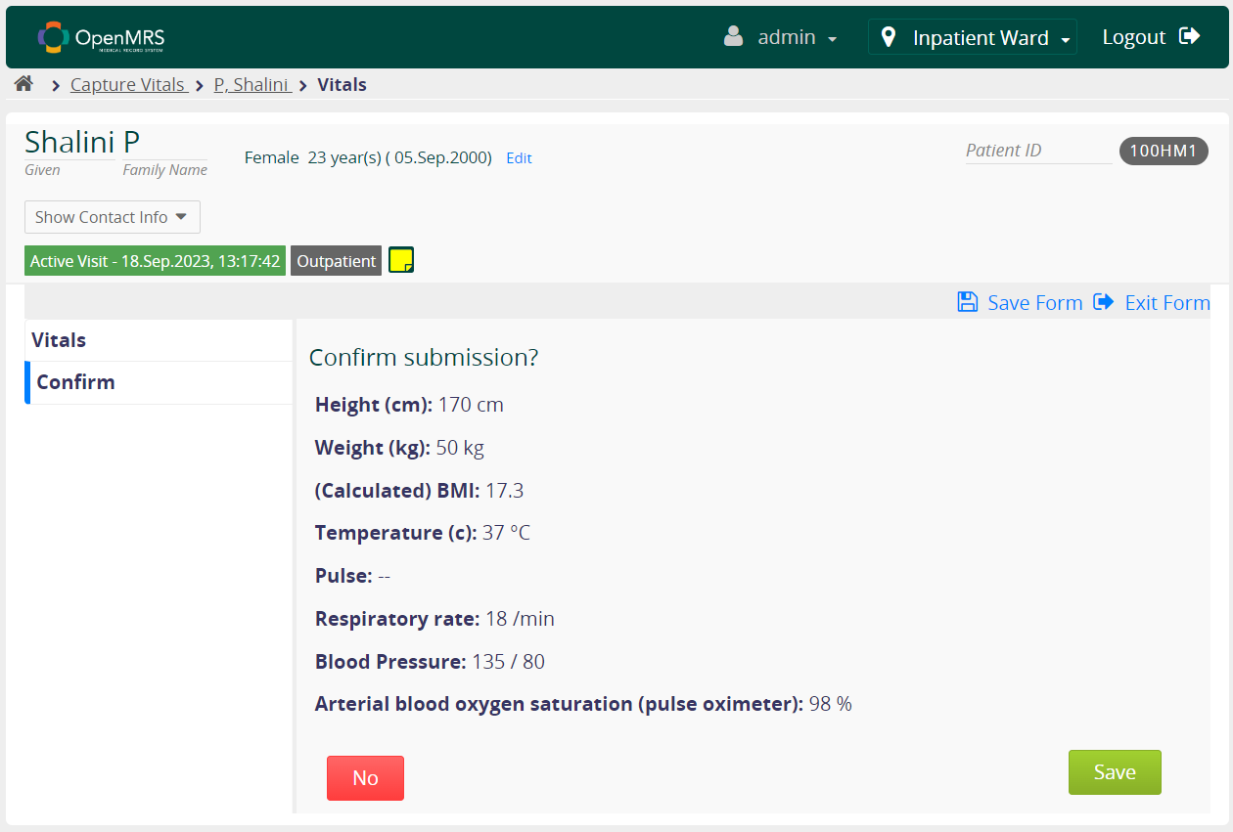
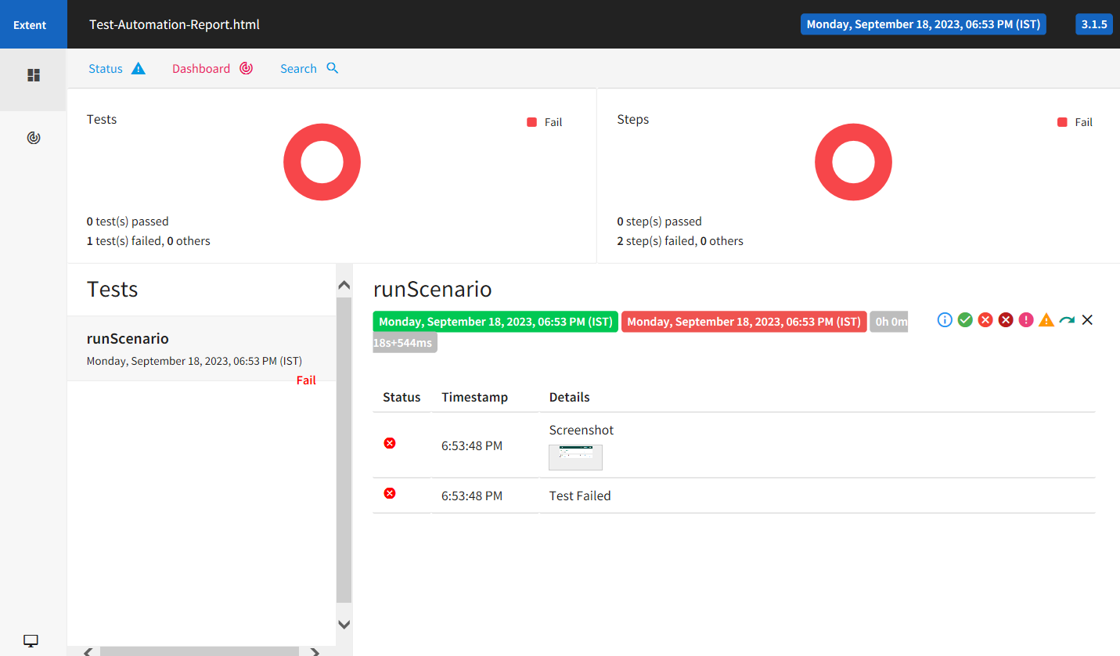
Capture Vitals with some Blank Data
In the capture vitals page select “Yes, Record Vitals”
In the form leave the Pulse as blank
Click on save button
We should not able to save the vitals
But it will save vitals that makes test case fail
Screenshot the page and attach it to report

Slide 25
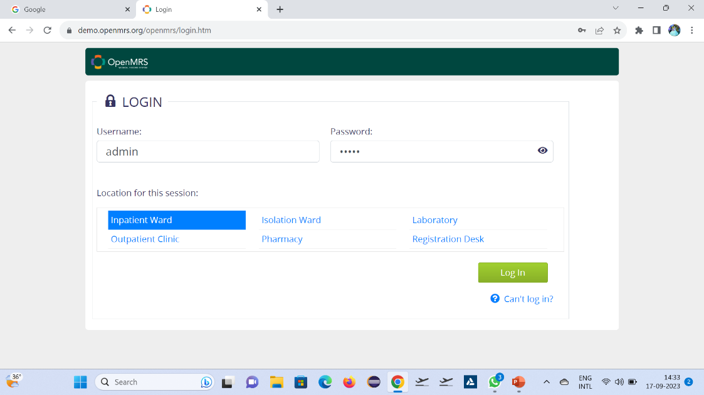
TEST SCENARIO-05
Scenario: Navigate to URL, login to the application. Click on Appointment Scheduling >> Manage Service Types. Click New Service Type to add New Service Type.
Steps to be followed to execute testcase for the above Scenario
A user is able to navigate to on the landing page
When he enters the login credentials and click on login
And he click on Appointment Scheduling.

Slide 26
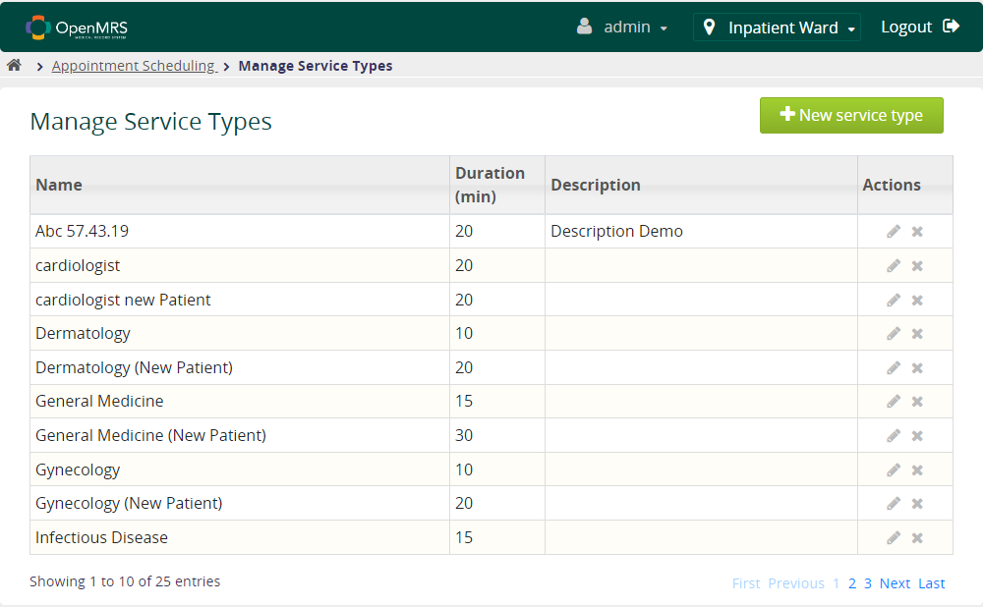
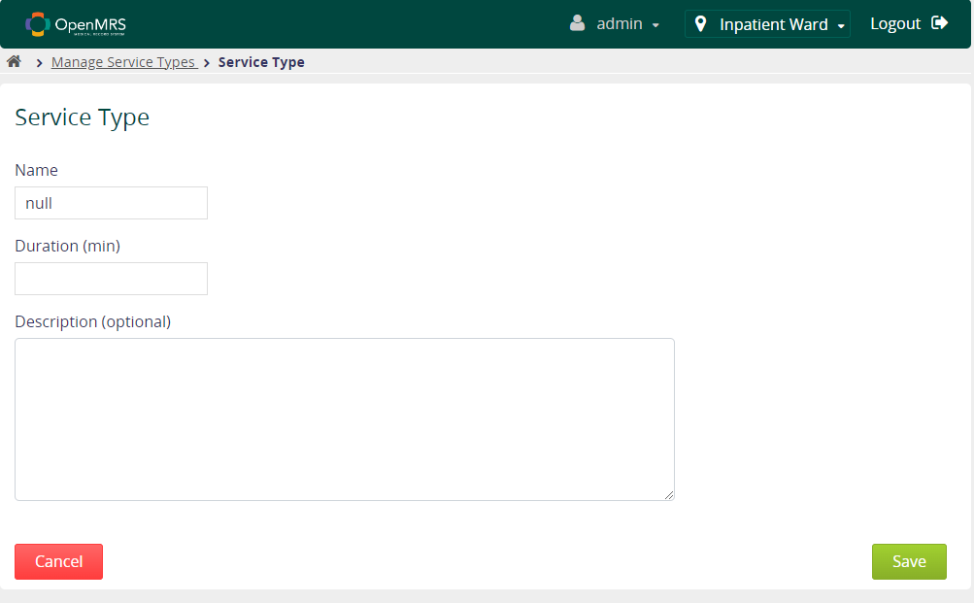
And he click on Appointment Scheduling.
And he click on Manage Service Types.
And he add New Service Type.
And he Click on name to add the Manage Service Type .
Then verify the test weather the data is added or not.

Slide 27
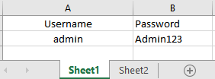
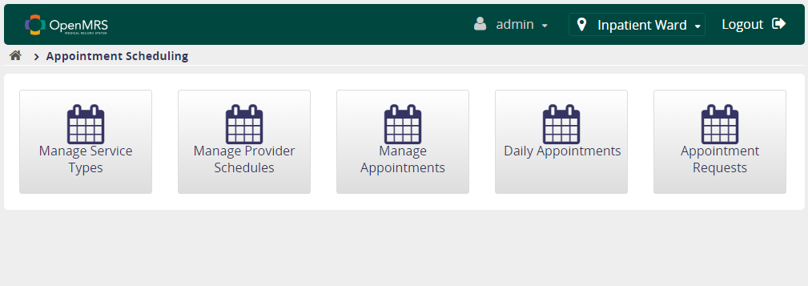
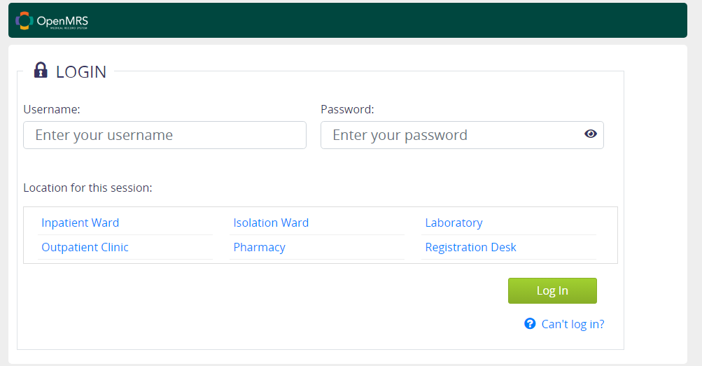
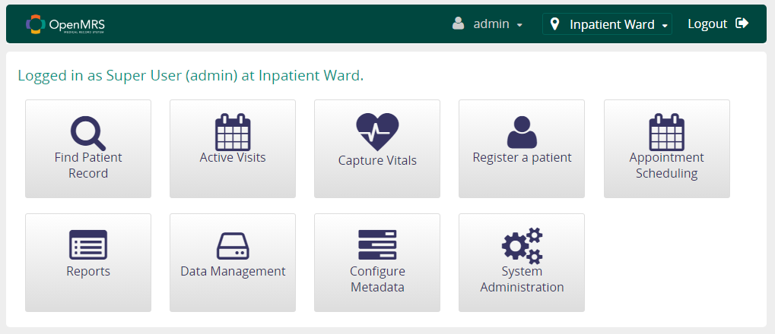
TEST SCENARIO-06
Navigate to the URL, login into the application. Click on Appointment Scheduling >> Manage Appointments. Search with “Je”. Choose anyone of the patient and perform the Patient Appointments
Feature File:
Feature: Manage appointment for patients
@tag2
Scenario: Manage Appointment
Given a user is on the landing page of openmrs website
And he entered valid credentials and click log in button
And he clicks Appointment Scheduling card
And he clicks Manage Appointments card
DDF
admin
Admin123

Slide 28
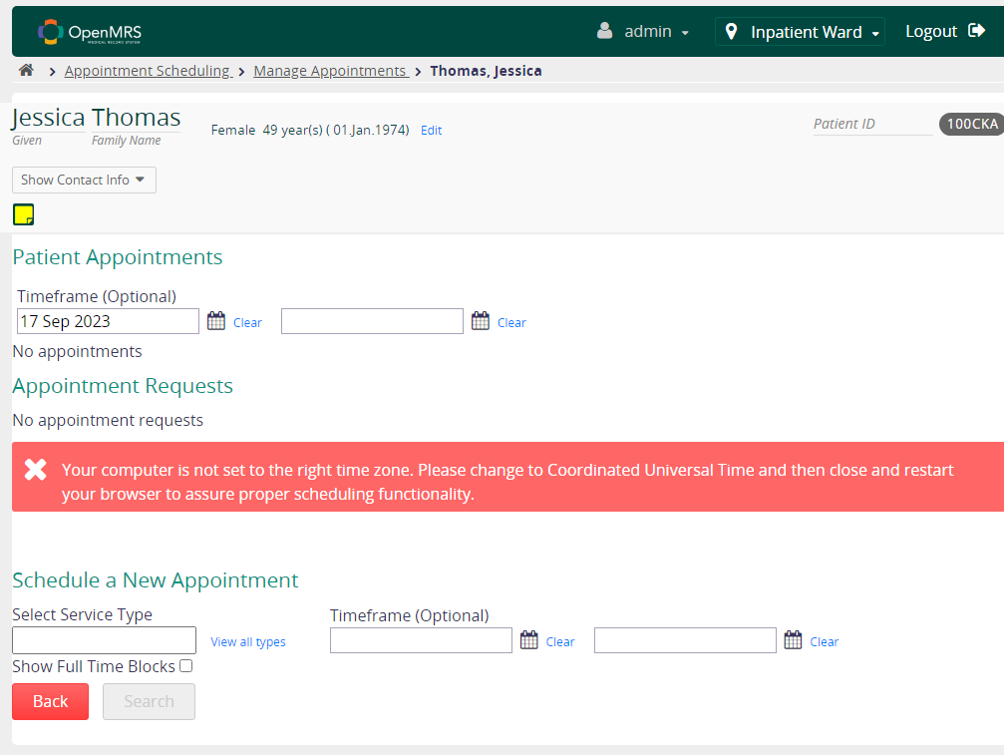
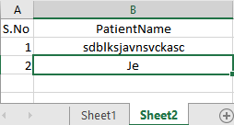
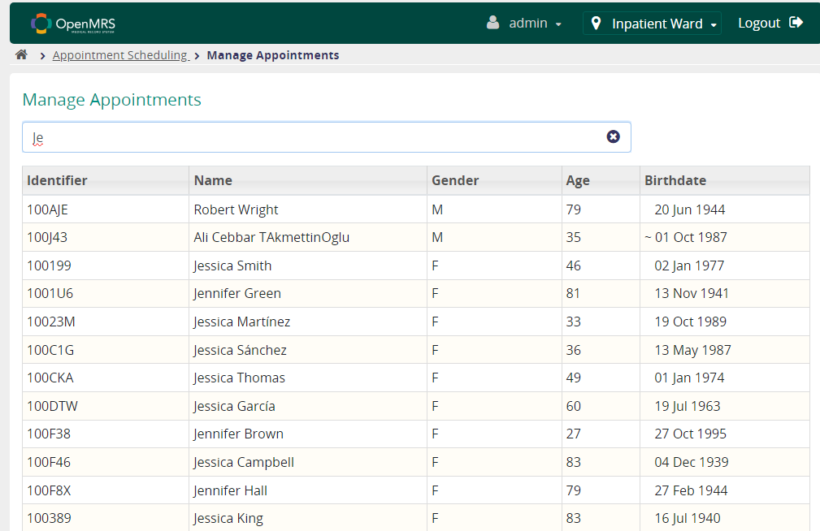
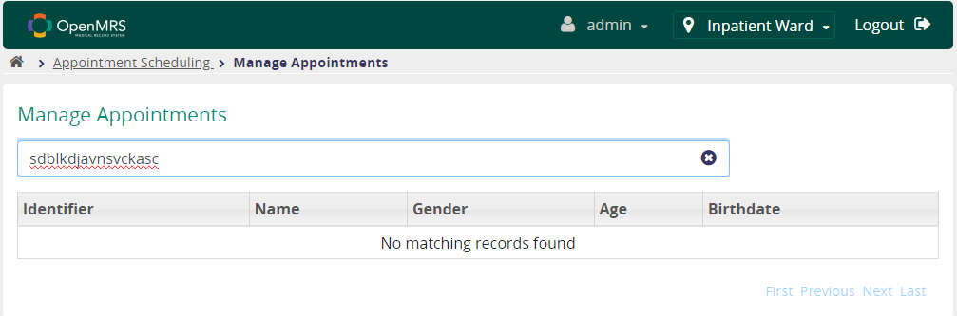
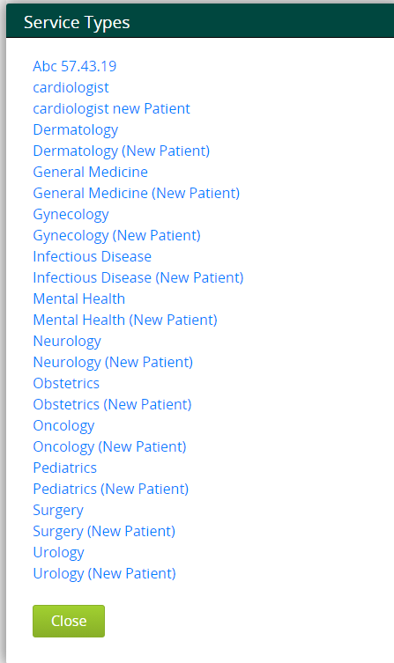
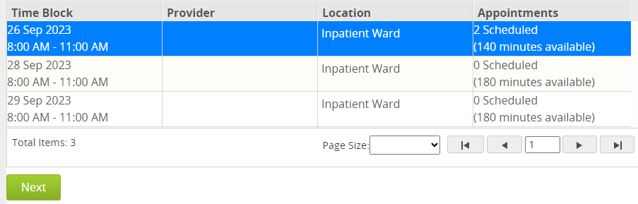
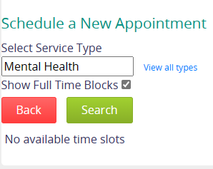
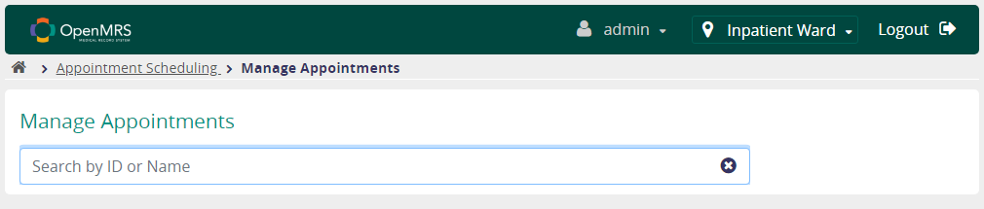
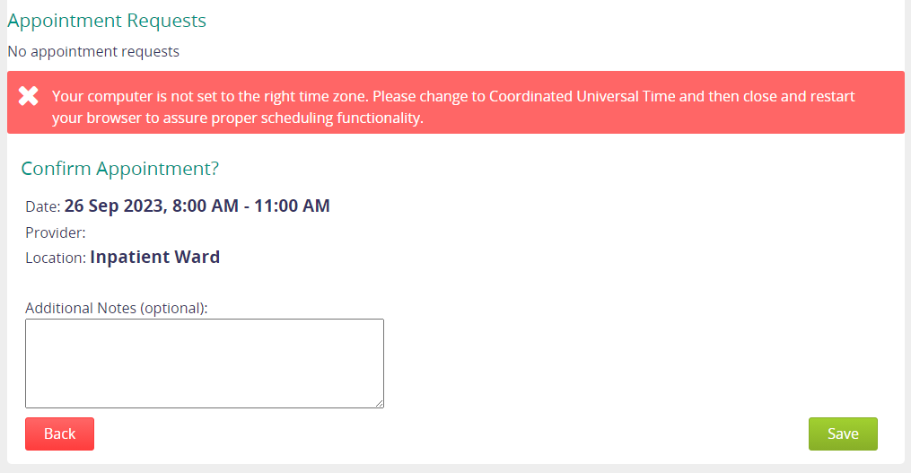
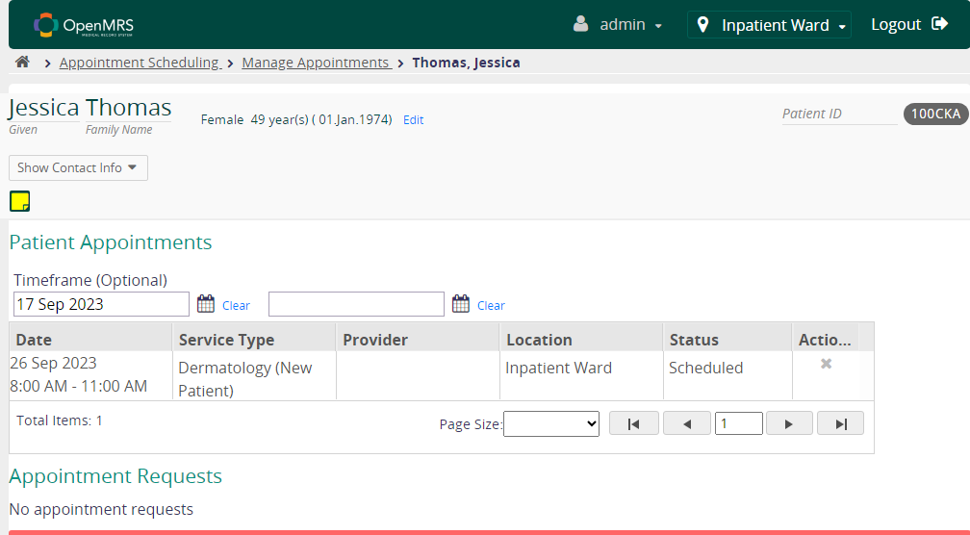

Data Driven Framework(DDF)
Feature: Manage appointment for patients
@tag2
Scenario: Manage Appointment
Given a user is on the landing page of openmrs website
And he entered valid credentials and click log in button
And he clicks Appointment Scheduling card
And he clicks Manage Appointments card
And he entered value and select patient
And he select service type
And select timeframe or click checkbox
And select time block
And click next
Then click Save
1
2
4
1
3
2
Finally,
5
.

Slide 29
TEST SCENARIO-07
Navigate to the URL, login into the application. Click on Appointment Scheduling >> Manage Appointment Blocks. Click on the calendar and Create Appointment Block.
Feature File for the above Scenario :
Feature: Create Appointment Block
Scenario: User must be able to create appointment block
Given a user is on the landing page of Open MRS
When a user enters the username and password details
And user selects the Inpatient Ward Location
And user clicks on the log in button
Then he must see the message - "Logged in as Super User (admin) at Inpatient Ward."
And user clicks on the Appointment Scheduling
And user clicks on the Manage Provider Schedules
Then user must see the message - "Manage Appointment Blocks“

Slide 30
Scenario: User must be able to create appointment block
And user selects the date for the calendar
And user selects user from the Provider list
And user enters service type from the services box
And user clicks on save
Then he must see the error message - "Can't save because the selected provider is already scheduled at this time."
And user clicks on cancel
And user clicks on created block and clicks on edit
Then he must verify the message - "Edit Appointment Block"
And user clicks on service type and selects required service
And user clicks on save button
Then he must see the final message - "Manage Appointment Blocks".

Slide 31
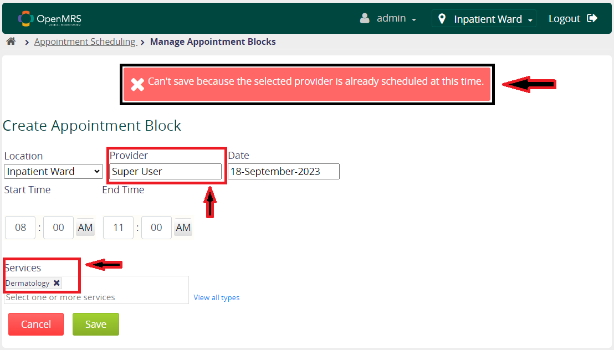
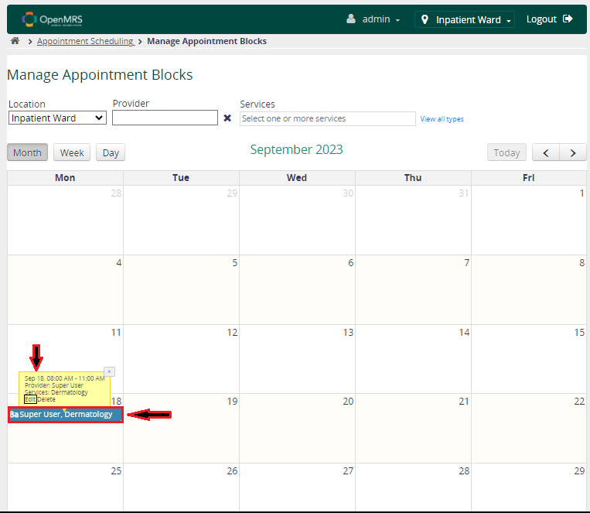
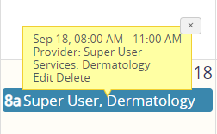

Slide 32
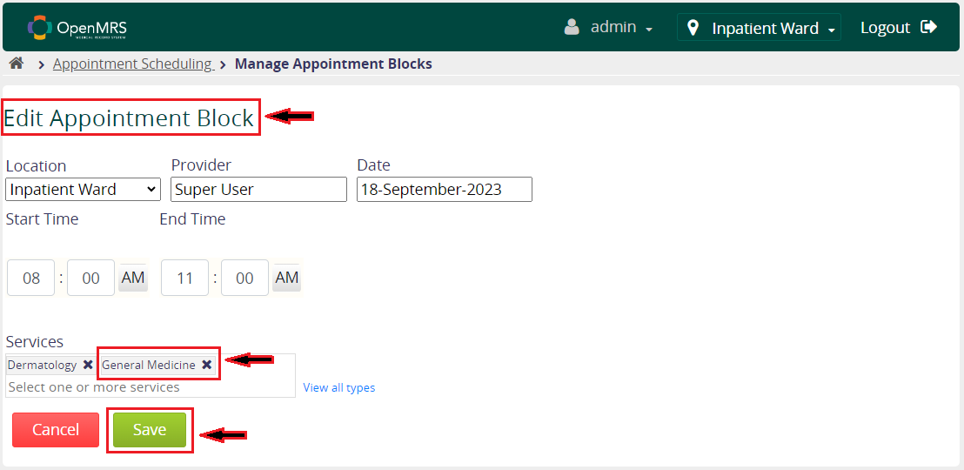
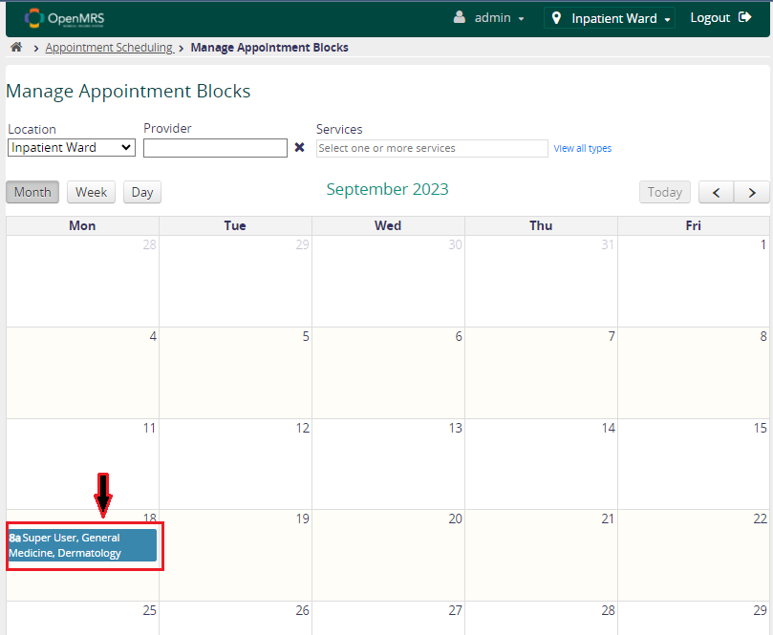

Slide 33
TEST SCENARIO-08
Scenario : Navigate to URL, login to the application, click on find Patient record, perform the search by id or name, click on any patient, click on edit registration
Steps to be followed to execute testcase for above Scenario
A user is able to navigate to on the landing page
When he enters the login credentials and click on login

Slide 34
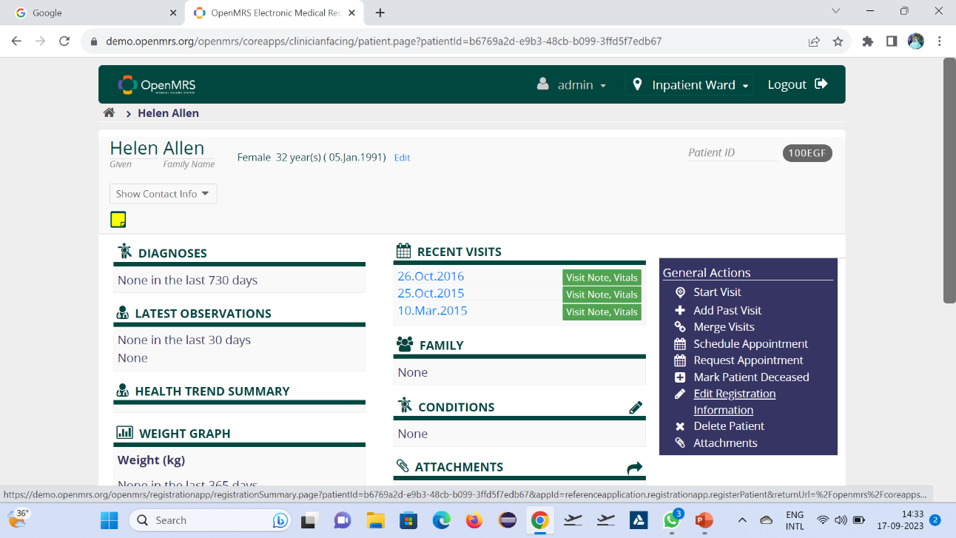
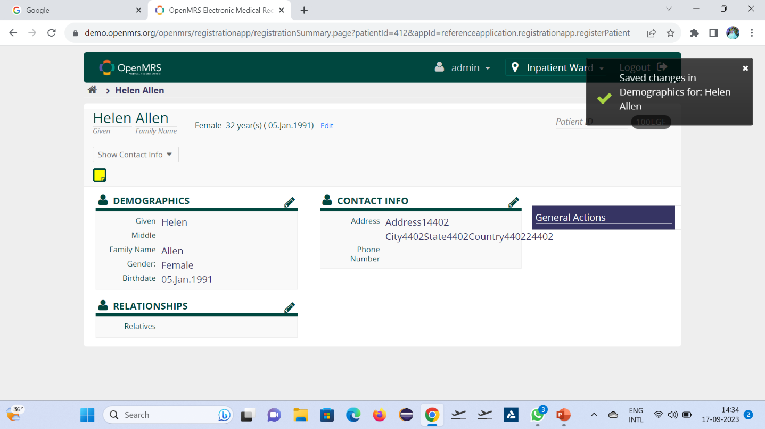
And he click on find patient record
And he enters the search id or name of patient
And he click on the patient data which he want to edit
And he click on edit Registration details
And he click on name to edit the name in registration
Then verify the test whether the data is edited or not

Slide 35
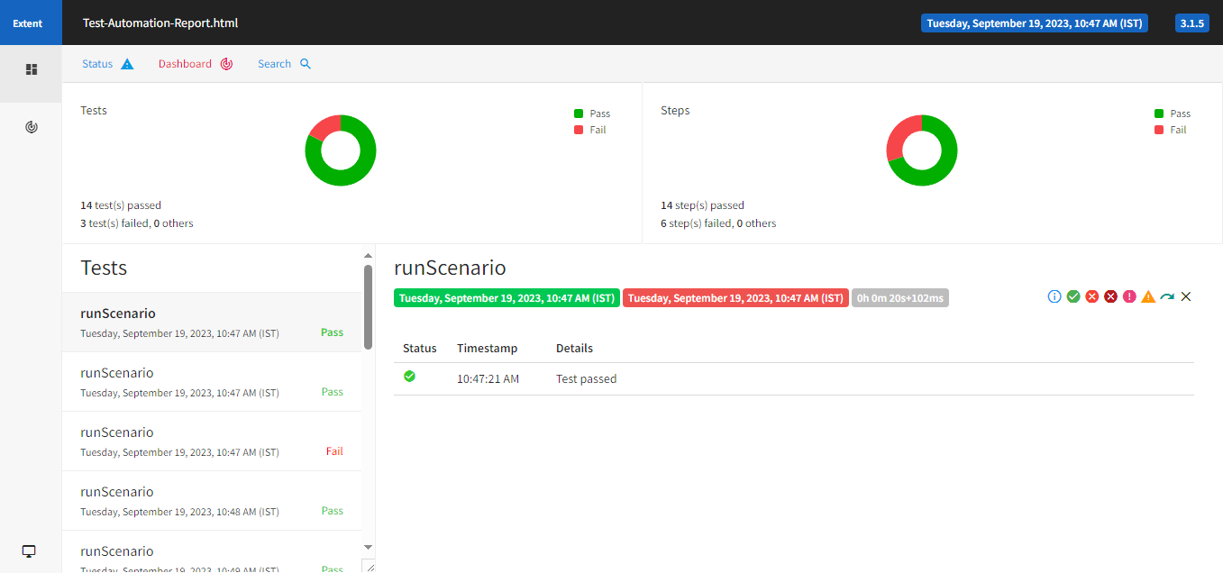
Extended Reports

Slide 36
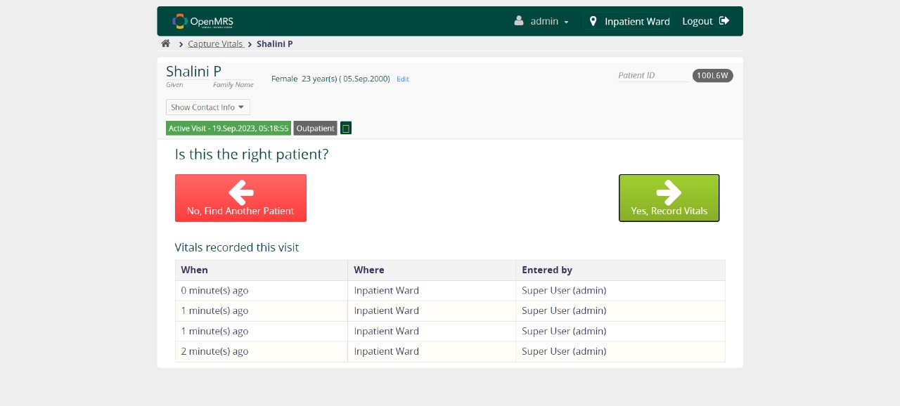
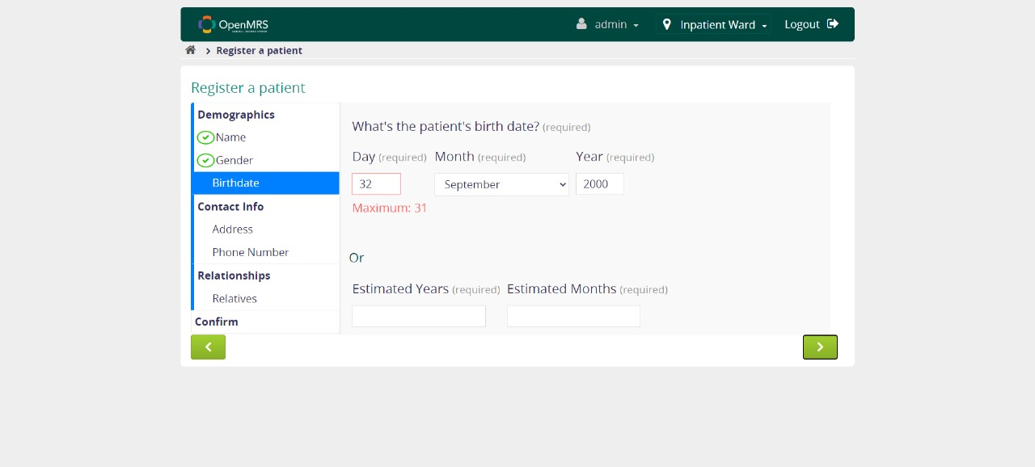
Screenshots

Slide 37
CONCLUSION
In conclusion, our extensive testing of the OpenMRS website across various critical scenarios.
Our rigorous examination ensures that OpenMRS continues to serve as a robust and efficient tool for hospital management.
We are confident that our efforts will contribute to the continued enhancement of healthcare systems, ultimately benefiting both healthcare providers and patients
Thank you for the opportunity to evaluate and improve this vital platform.

Slide 38


